Slide 1
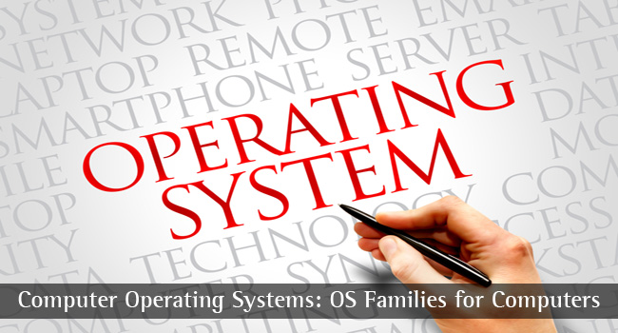
CS-3103 : Operating Systems : Sec-A (NB) : Threads
HIT-BTech-CSEN3103-Operating Systems

Slide 2
Interprocess Communications
Communication is a means of sharing information between at least two agent.
A communication consists of an individual sending some information and another receiving that information.
Five elements are involved in a communication: 1) the situation (when, where and what circumstance) that triggers the communication, 2) the information to be communicated, 3) the sender of the information, 4) the medium of transmitting the information, and 5) the receiver of the information.
HIT-BTech-CSEN3103-Operating Systems

Slide 3
Interprocess Communications…
The agents involved in communications in operating systems are processes, threads, kernel and processors.
In systems involving multiple processes, concurrent processes may interact with one another to 1) exchange information to achieve some common goal, and 2) coordination (i.e., synchronization) of activities of the participating processes.
Each interaction involves exchanging a finite amount of information (i.e., data transfer) between two or more processes.
HIT-BTech-CSEN3103-Operating Systems

Slide 4
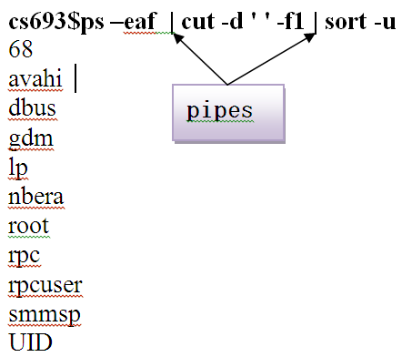
IPC – PIPE …
In UNIX systems, pipes are normally used as unidirectional byte streams which connect the standard output from one process to the standard input of another process.
HIT-BTech-CSEN3103-Operating Systems

Slide 5

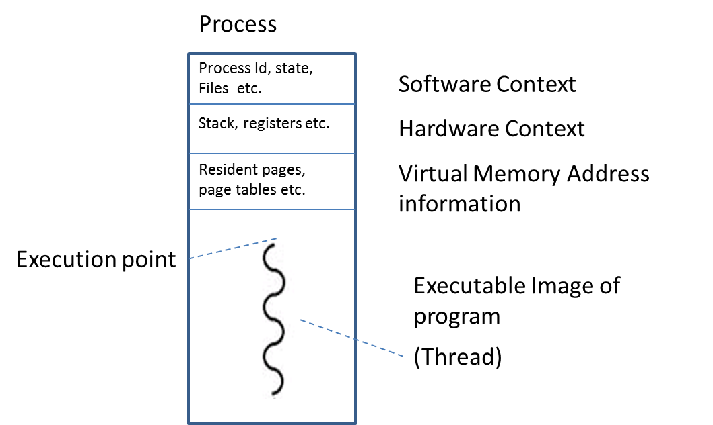
Let’s learn Threads
A process comprises four components:
    Executable image of the program
    Software context
    Hardware context
    Virtual memory address information
In a normal program, there is only one execution point that is the location in the program from where the execution of the program begins.
HIT-BTech-CSEN3103-Operating Systems

Slide 6
Let’s learn Threads …..
The execution point is the address of the first executable statement in a program;
Thus, this address is initially stored in the hardware context.
When the process is dispatched for execution, this address gets automatically loaded into the program counter (PC) with the context of the process.
As execution progresses, the contents of the program counter are incremented or changed.
Note: There is only one sequence of instruction in a normal process.
This sequence of instruction is also called a thread.
HIT-BTech-CSEN3103-Operating Systems

Slide 7
Let’s learn Threads
A thread is a sequence of instructions within a process.
It is an executable entity that runs in the address space of its container process, and uses the resources of the process.
We have seen that a process switch involves an overhead in the form of saving and loading outgoing and incoming processes respectively.
This overhead becomes more significant when the process is I/O bound because such a process frequently occupies and leaves the CPU.
In order to reduce this overhead, modern OS allow the inclusion of multiple execution streams in a single process. This means if a programmer can identify different activities in the program that can run independently of each other, then he/she may include multiple threads in the program (figure in the next slide)…..
HIT-BTech-CSEN3103-Operating Systems

Slide 8
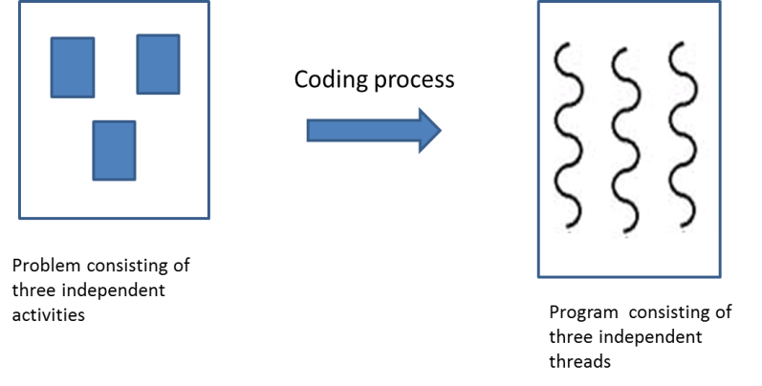
Let’s learn Threads
Note: The program represented in the following figure has three concurrent threads; hence three execution points. The term “concurrent threads” means that the threads have an overlap of CPU execution time.
HIT-BTech-CSEN3103-Operating Systems

Slide 9
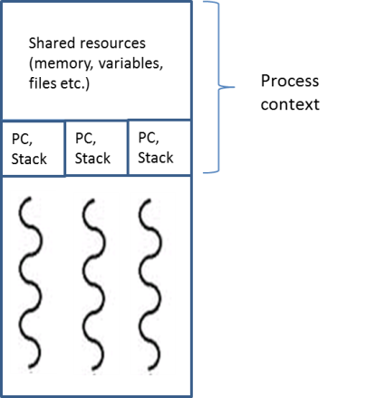
Let’s learn Threads
When the OS loads this multithreaded program into main memory, it opens a process for this program. Various threads of the process (in this case 4, one for the main program where the entire code of execution is written plus three threads created through pthread_create(a,b,c,d) system call) will share most of the resources such as heaps, file, tables, devices etc. However, each thread will have its own thread context consisting of stack and program counter, state, and registers. Therefore, a separate area is allocated for a thread in the hardware context of process control block, for storing thread context. Shown in the picture ➔
Multithreading is the act of creating multiple independent instruction streams, called threads, in a process.
HIT-BTech-CSEN3103-Operating Systems

Slide 10
Pthreads
Pthreads refers to the POSIX standard (IEEE 1003.1c) defining an API for thread creation and synchronization.
pthread_t tid → declares the identifier for the thread we will create.
Each thread has a set of attributes including stack size and scheduling information.
Pthread_attr_t attr → represents attributes for the thread.
Set the attributes → pthread_attr_init(&attr)
A separate thread is created with pthread_create function call with 4 arguments.
HIT-BTech-CSEN3103-Operating Systems

Slide 11
Pthreads (continued)
pthread_create(&tid, &attr, function, parameters for func)
&tid → pass thread identifier
&attr → pass attributes for the thread
Function → where the new thread will begin execution
Parameters (if any) required for the Function execution
HIT-BTech-CSEN3103-Operating Systems

Slide 12
Program to create a thread with Pthreads library… Run this program and check the attributes for thread creation, pthread_create(a,b,c,d) and pthread_join(a,b)….
#include <stdio.h>
#include <stdlib.h>
#include <pthread.h>
// A normal C function that is executed as a thread
// when its name is specified in pthread_create()
void *myThreadFun(void *vargp)
{
sleep(1);
printf("Printing GeeksQuiz from Thread \n");
return NULL;
}
int main()
{
pthread_t thread_id;
printf("Before Thread\n");
pthread_create(&thread_id, NULL, myThreadFun, NULL);
pthread_join(thread_id, NULL);
printf("After Thread\n");
exit(0);
}
HIT-BTech-CSEN3103-Operating Systems

Slide 13
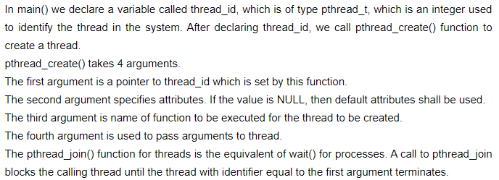
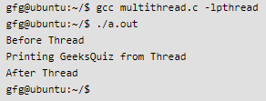
Result of running a Thread program…
HIT-BTech-CSEN3103-Operating Systems

Slide 14
Program to show Multithreading with Pthreads library…
#include <stdio.h>
#include <stdlib.h>
#include <pthread.h>
// Let us create a global variable to change it in threads
int g = 0;
// The function to be executed by all threads
void *myThreadFun(void *vargp)
{
// Store the value argument passed to this thread
int *myid = (int *)vargp; // variable-global-pointer
// Let us create a static variable to observe its changes
static int s = 0;
// Change static and global variables
++s; ++g;
// Print the argument, static and global variables
printf("Thread ID: %d, Static: %d, Global: %d\n", *myid, ++s, ++g);
}
int main()
{
int i;
pthread_t tid;
// Let us create three threads……………………………….. Check the output
for (i = 0; i < 3; i++)
pthread_create(&tid, NULL, myThreadFun, (void *)&i);
pthread_exit(NULL);
return 0;
}
HIT-BTech-CSEN3103-Operating Systems

Slide 15
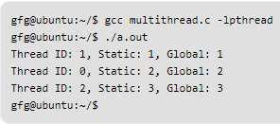

Result of running Multiple Threads…
HIT-BTech-CSEN3103-Operating Systems

Slide 16
Types of Threads
There are two types of threads:
    User level threads
    Kernel level threads
  There is a major difference in terms of visibility of threads.
    The kernel level threads are visible to the OS whereas the user level threads are not visible to the OS. The user level threads are visible only to the user. Thus, threads are visible only to their owners.
HIT-BTech-CSEN3103-Operating Systems

Slide 17
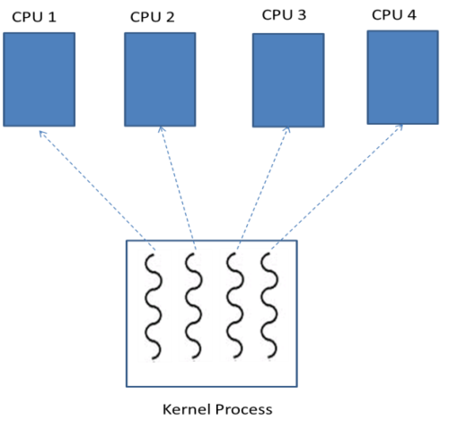
Scheduling of Threads
Since the OS is the owner of kernel level threads, it can schedule these threads. In a multiprocessor environment, the OS can map its threads on different processors. In the following figure, the OS has scheduled 4 threads on 4 different CPUs ➔ utilizing the power of parallel hardware available to the system.
Example: the file server, exception handler, memory manager, and other processes of the kernel and coded as multithreaded processes.
HIT-BTech-CSEN3103-Operating Systems

Slide 18

HIT-BTech-CSEN3103-Operating Systems

Slide 19
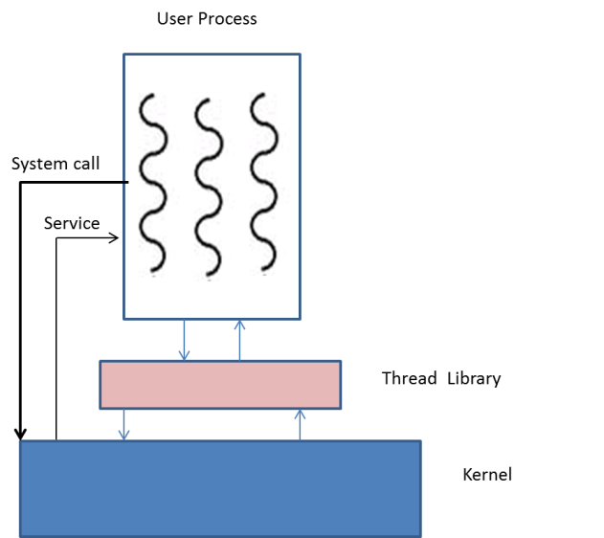
Scheduling of Threads
User level threads are not visible to the OS.
The kernel cannot directly schedule these threads.
The user can manage his threads with the help of a thread library.
HIT-BTech-CSEN3103-Operating Systems

Slide 20
Scheduling of Threads (We are talking about java threads)
Considering a single CPU design, threads run one at a time in such a way as to provide an illusion of concurrency.
Execution of multiple threads on a single CPU in some order is called scheduling.
The Java runtime environment supports a very simple, deterministic scheduling algorithm called fixed-priority scheduling.
This algorithm schedules threads on the basis of their priority relative to other Runnable threads
When a thread is created, it inherits its priority from the thread that created it. (example: main thread of execution of the running program, i.e., a process)
We also can modify a thread's priority at any time after its creation by using the setPriority method.
HIT-BTech-CSEN3103-Operating Systems

Slide 21
Scheduling of Threads
Thread priorities are integers ranging between MIN_PRIORITY and MAX_PRIORITY (constants defined in the Thread class).
The higher the integer, the higher the priority.
At any given time, when multiple threads are ready to be executed, the runtime system chooses for execution the Runnable thread that has the highest priority.
Only when that thread stops, yields, or becomes Not Runnable will a lower-priority thread start executing.
If two threads of the same priority are waiting for the CPU, the scheduler arbitrarily chooses one of them to run. The chosen thread runs until one of the following conditions is true:
A higher priority thread becomes runnable.
It yields, or its run method exits.
On systems that support time-slicing, its time allotment has expired.
Then the second thread is given a chance to run, and so on, until the interpreter exits.
The Java runtime system's thread scheduling algorithm is also preemptive.
If at any time a thread with a higher priority than all other Runnable threads becomes Runnable, the runtime system chooses the new higher-priority thread for execution.
The new thread is said to preempt the other threads.
http://www.iitk.ac.in/esc101/05Aug/tutorial/essential/threads/priority.html
HIT-BTech-CSEN3103-Operating Systems

Slide 22
Threads (more slides follows… same idea is explained in a different way…from dhamdhere… leisure time reading….)
A thread (or lightweight process but not a process by itself) is a basic unit of CPU utilization; it consists of: a thread ID, program counter, register set, stack space
A thread shares with its peer threads its: code section, data section, operating-system resources collectively know as a task.
A traditional or heavyweight process is equal to a task with a single thread of control.
If the process has multiple threads of control, it can do more than one task at a time.
HIT-BTech-CSEN3103-Operating Systems

Slide 23
Threads
Thread cannot run on its own;
It always runs within a process.
Thus, a multithreaded process may have multiple execution flows, different ones belonging to different threads.
These threads share the same private address space of the process, and they share all the resources acquired by the process.
They run in the same process execution context, and therefore, one thread may influence other threads in the process.
HIT-BTech-CSEN3103-Operating Systems

Slide 24

Single and Multithreaded Processes
HIT-BTech-CSEN3103-Operating Systems

Slide 25
Let’s look at thread creation….
pthreads - POSIX threads (http://man7.org/linux/man-pages/man7/pthreads.7.html)
Pthreads function return values Most pthreads functions return 0 on success, and an error number on failure.
Thread IDs Each of the threads in a process has a unique thread identifier (stored in the type pthread_t). This identifier is returned to the caller of pthread_create(), and a thread can obtain its own thread identifier using pthread_self(void) [http://man7.org/linux/man-pages/man3/pthread_self.3.html]
pthread_create - create a new thread [http://man7.org/linux/man-pages/man3/pthread_create.3.html]
#include <pthread.h>
int pthread_create(pthread_t *thread, const pthread_attr_t *attr, void *(*start_routine) (void *), void *arg);
Compile and link with -lpthread.
HIT-BTech-CSEN3103-Operating Systems

Slide 26
Let’s look at void * pointer needed for thread creation….
A void pointer is a pointer that has no associated data type with it. A void pointer can hold address of any type and can be type-casted to any type.
#include<stdio.h>
int main() {
int a = 10;
void *ptr = &a;
printf("%d", *(int *)ptr);
return 0;
}
Output : 10
HIT-BTech-CSEN3103-Operating Systems

Slide 27
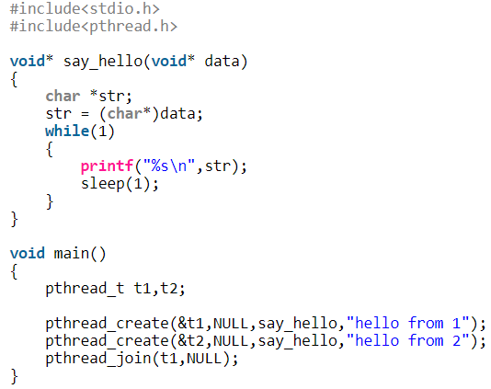
Let’s look at thread creation….
HIT-BTech-CSEN3103-Operating Systems

Slide 28
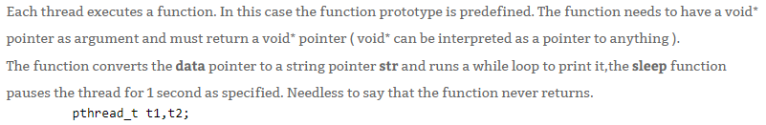

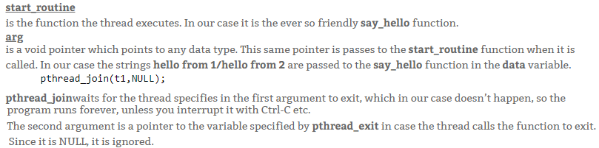
Explanation of previous program….
HIT-BTech-CSEN3103-Operating Systems

Slide 29
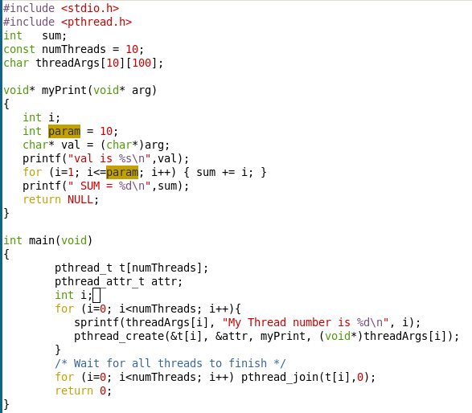
Multithreaded Processes
HIT-BTech-CSEN3103-Operating Systems

Slide 30
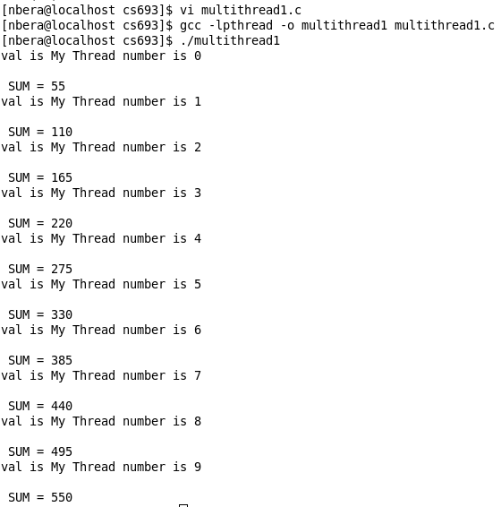
Running Multithreaded Processes - Result
HIT-BTech-CSEN3103-Operating Systems

Slide 31
Motivation of thread creation
Assertion: Many software packages that run on modern desktop PCs are multithreaded.
An application is implemented as a separate process with several threads of control.
A word processor may have 1) a thread for displaying graphics; 2) another thread for reading keystrokes from the user; 3) third one for performing spelling and grammar checking in the background.
In certain situation a single application may be required to perform several similar tasks.
HIT-BTech-CSEN3103-Operating Systems

Slide 32
Motivation of thread creation
Example: A web server accepts client requests for web pages, sound, and so forth.
A busy web server may have several (e.g., hundreds) clients concurrently accessing it.
If the word server ran as a traditional single-treaded process, only one client request may be served at a time. The amount of time that a client might have to wait for its request to be serviced could be enormous.
Solution: Server creating multiple threads.
HIT-BTech-CSEN3103-Operating Systems

Slide 33
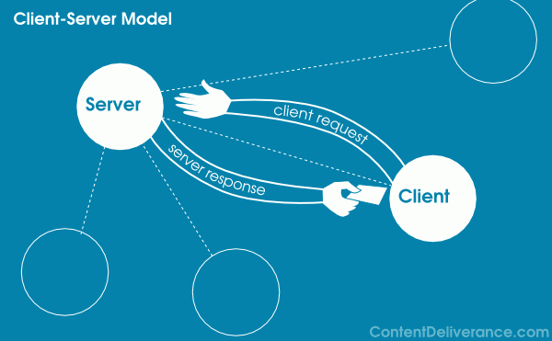
Application of Threads
HIT-BTech-CSEN3103-Operating Systems

Slide 34
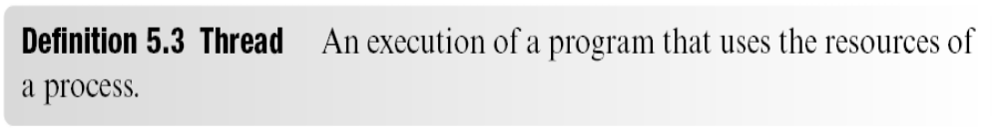
Threads…
A thread is an alternative model of program execution
A process creates a thread through a system call
Thread operates within process context
Use of threads effectively splits the process state into two parts
  Resource state remains with process
  CPU state is associated with thread
Switching between threads incurs less overhead than switching between processes
HIT-BTech-CSEN3103-Operating Systems

Slide 35
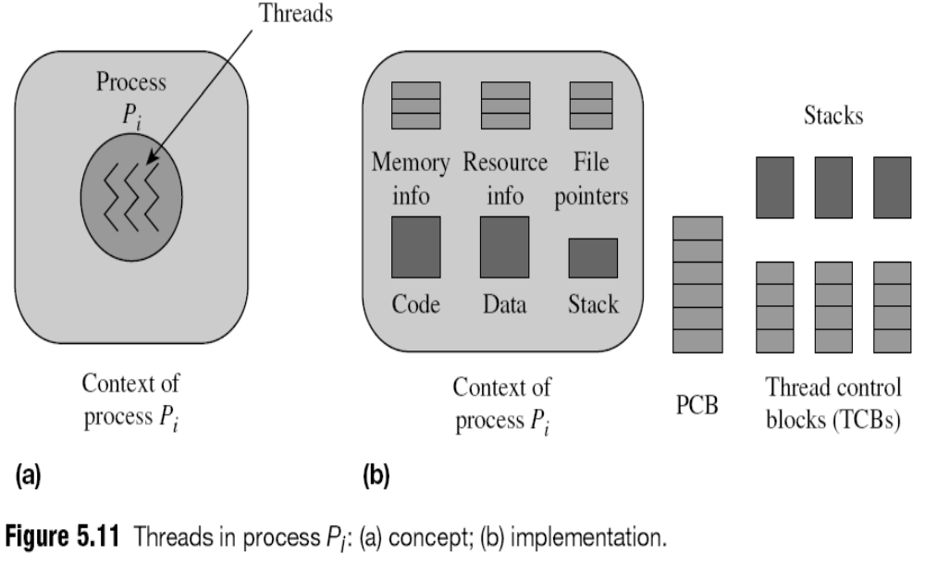
Threads…
HIT-BTech-CSEN3103-Operating Systems

Slide 36
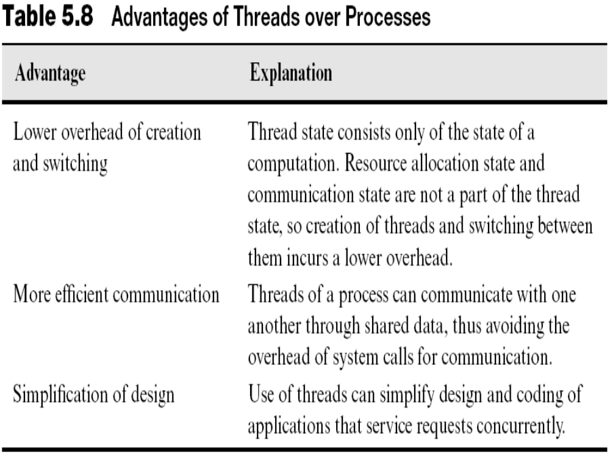
HIT-BTech-CSEN3103-Operating Systems

Slide 37
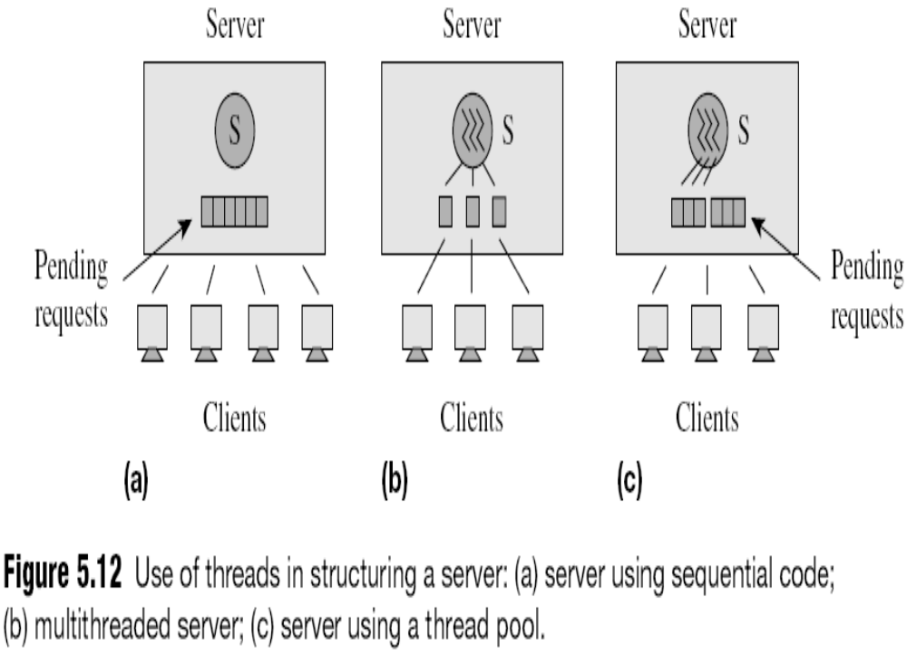
HIT-BTech-CSEN3103-Operating Systems

Slide 38
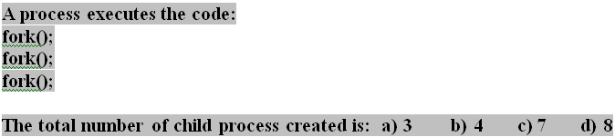
Assignments on Process and Scheduling
HIT-BTech-CSEN3103-Operating Systems

Slide 39
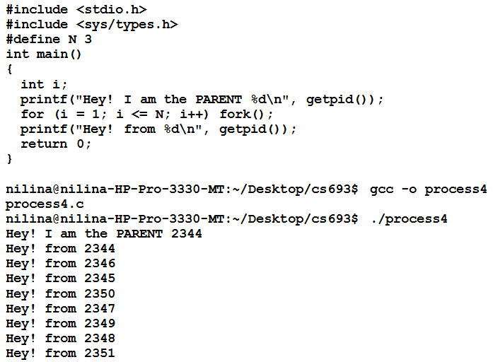
Answer in detail….
HIT-BTech-CSEN3103-Operating Systems

Slide 40
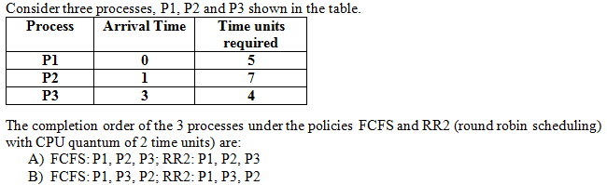
Process Scheduling….
HIT-BTech-CSEN3103-Operating Systems

Slide 41
Answer in detail….
P3 exits
P1 exits
E_{P1}=2
E_{P2}=2
E_{P3}=2
E_{P1}=2
E_{P2}=2
E_{P3}=2
E_{P1}=1
E_{P2}=3
P1 | P2 | P3 | P1 | P2 | P3 | P1 | P2
0
2
4
6
8
10
12
13
16
R_{P1}=3
R_{P2}=5
R_{P3}=2
R_{P1}=1
R_{P2}=3
R_{P3}=0
R_{P1}=0
R_{P2}=0
HIT-BTech-CSEN3103-Operating Systems

Slide 42
UNIX PROCESS MANAGEMENT
Unix assigns a process number to every process present in the system.
At the time of booting, a special process called process 0 is created. It is called the swapper process.
Thereafter, every process in Unix is created by the ‘fork’ system call.
Process 0 becomes a parent process and forks a child process called process 1 that is also named ‘init’ process which, in turn, spawns its child processes.
The child processes spawn their own child processes, and so on. Therefore, the ‘init’ process becomes an ancestor of all the processes present in the system.
HIT-BTech-CSEN3103-Operating Systems

Slide 43
UNIX PROCESS MANAGEMENT …..
An executable file in Unix has many components, including the program text and data.
The executable file is loaded into the system by the ‘exec’ system call.
The operating System opens a process for the loaded file and assigns a stack to it.
Thus, the process space consists of three regions → text, data and stack.
The process gets an entry into the process table and the kernel reserves a user area (also called ‘u area’) for the process.
HIT-BTech-CSEN3103-Operating Systems

Slide 44
Kernel-Level, User-Level, and Hybrid Threads
User-Level Threads
  Threads are managed by thread library.
  This library provides support for thread creation, scheduling, and management with no support from kernel.
  Because the kernel is unaware of user-level threads, all thread creation and scheduling are done in user space without the need for kernel intervention.
  Therefore, user-level threads are generally fast to create and manage.
HIT-BTech-CSEN3103-Operating Systems

Slide 45
Kernel-Level, User-Level, and Hybrid Threads
Kernel-Level Threads
  Thread-management is done by the operating system
  The kernel performs thread creation, scheduling and management in kernel space.
  Kernel threads are generally slower to create and manage than are user threads.
  Since the kernel is managing the threads, if a thread performs a blocking system call, the kernel can schedule another thread in the application for execute.
Hybrid Threads
  Combination of kernel-level and user-level threads
HIT-BTech-CSEN3103-Operating Systems

Slide 46
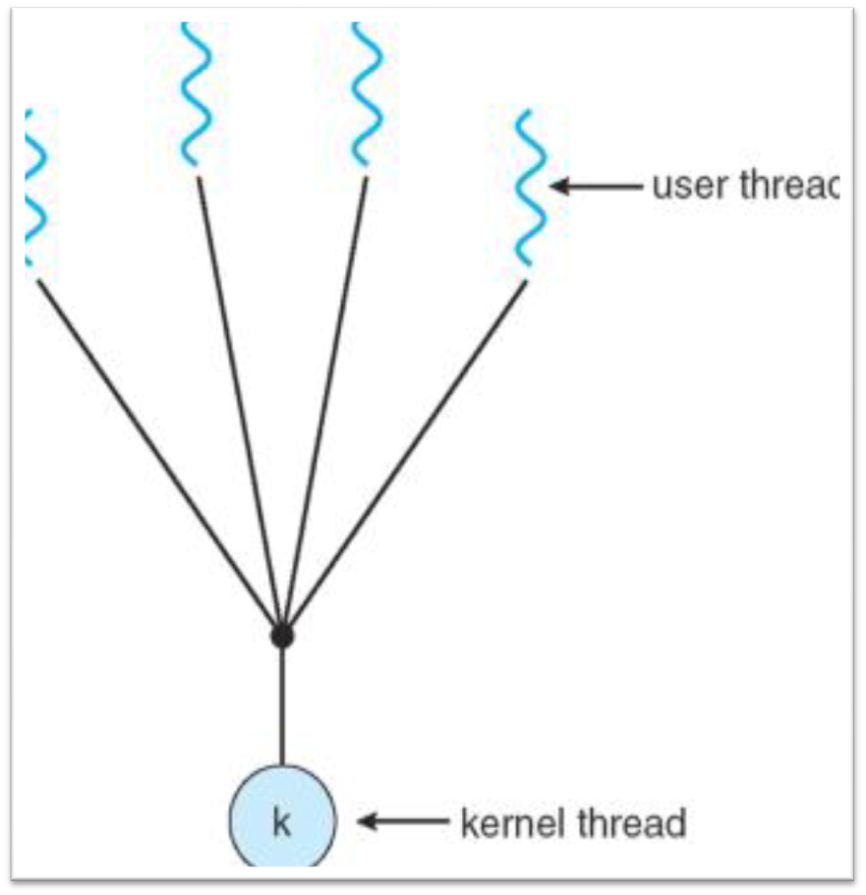
Many-to-One Model
This model maps many user-level threads to one kernel thread. Thread management is done at user space, so it is efficient, but the entire process will block if a thread makes a blocking system call.
Only one thread can access the kernel at a time, multiple threads are unable to run in parallel on multiprocessor.
HIT-BTech-CSEN3103-Operating Systems

Slide 47
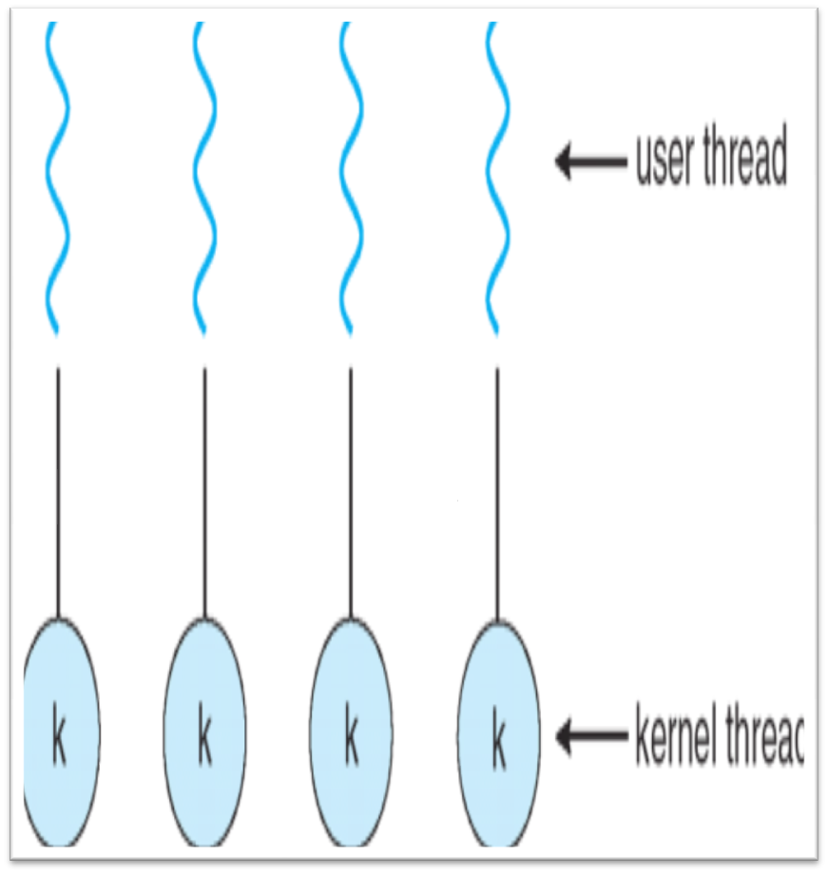
One-to-one Model
This model maps each user thread to a kernel thread.
It provides more concurrency than the many-to-one model by allowing another thread to run when a thread makes a blocking system call.
It also allows multiple threads to run in parallel on multiprocessors.
HIT-BTech-CSEN3103-Operating Systems

Slide 48
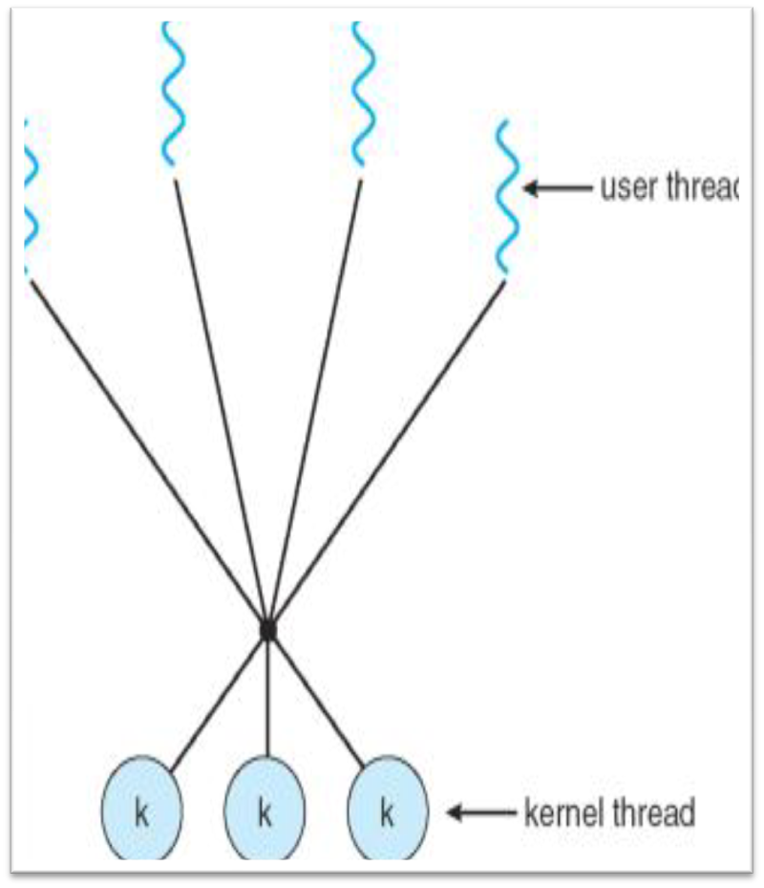
Many-to-Many Model
The many-to-many model multiplexes many user-level threads to a smaller or equal number of kernel threads.
The number of kernel threads may be specific to either a particular application or a particular machine (an application may be allocated more kernel threads on a multiprocessor than on a uniprocessor).
HIT-BTech-CSEN3103-Operating Systems

Slide 49
Threads (Cont.)
In a multiple threaded task, while one server thread is blocked and waiting, a second thread in the same task can run.
  Cooperation of multiple threads in same job confers higher throughput and improved performance.
  Applications that require sharing a common buffer (i.e., producer-consumer) benefit from thread utilization.
Threads provide a mechanism that allows sequential processes to make blocking system calls while also achieving parallelism.
Kernel-supported threads (Mach and OS/2).
User-level threads; supported above the kernel, via a set of library calls at the user level (Project Andrew from CMU).
Hybrid approach implements both user-level and kernel-supported threads (Solaris 2).
HIT-BTech-CSEN3103-Operating Systems

Slide 50
Threads Support in Solaris 2
Solaris 2 is a version of UNIX with support for threads at the kernel and user levels, symmetric multiprocessing, and
real-time scheduling.
LWP – intermediate level between user-level threads and kernel-level threads.
Resource needs of thread types:
  Kernel thread: small data structure and a stack; thread switching does not require changing memory access information – relatively fast.
  LWP: PCB with register data, accounting and memory information,; switching between LWPs is relatively slow.
  User-level thread: only ned stack and program counter; no kernel involvement means fast switching. Kernel only sees the LWPs that support user-level threads.
HIT-BTech-CSEN3103-Operating Systems

Slide 51

Solaris 2 Threads
HIT-BTech-CSEN3103-Operating Systems

Slide 52
Interprocess Communication (IPC)
Mechanism for processes to communicate and to synchronize their actions.
Message system – processes communicate with each other without resorting to shared variables.
IPC facility provides two operations:
  send(message) – message size fixed or variable
  receive(message)
If P and Q wish to communicate, they need to:
  establish a communication link between them
  exchange messages via send/receive
Implementation of communication link
  physical (e.g., shared memory, hardware bus)
  logical (e.g., logical properties)
HIT-BTech-CSEN3103-Operating Systems

Slide 53
Direct Communication
Processes must name each other explicitly:
  send (P, message) – send a message to process P
  receive(Q, message) – receive a message from process Q
Properties of communication link
  Links are established automatically.
  A link is associated with exactly one pair of communicating processes.
  Between each pair there exists exactly one link.
  The link may be unidirectional, but is usually bi-directional.
HIT-BTech-CSEN3103-Operating Systems

Slide 54
Indirect Communication
Messages are directed and received from mailboxes (also referred to as ports).
  Each mailbox has a unique id.
  Processes can communicate only if they share a mailbox.
Properties of communication link
  Link established only if processes share a common mailbox
  A link may be associated with many processes.
  Each pair of processes may share several communication links.
  Link may be unidirectional or bi-directional.
Operations
  create a new mailbox
  send and receive messages through mailbox
  destroy a mailbox
HIT-BTech-CSEN3103-Operating Systems

Slide 55
Indirect Communication (Continued)
Mailbox sharing
  P₁, P₂, and P₃ share mailbox A.
  P₁, sends; P₂ and P₃ receive.
  Who gets the message?
Solutions
  Allow a link to be associated with at most two processes.
  Allow only one process at a time to execute a receive operation.
  Allow the system to select arbitrarily the receiver. Sender is notified who the receiver was.
HIT-BTech-CSEN3103-Operating Systems

Slide 56
Buffering
Queue of messages attached to the link; implemented in one of three ways.
  1. Zero capacity – 0 messages
  Sender must wait for receiver (rendezvous).
  2. Bounded capacity – finite length of n messages
  Sender must wait if link full.
  3. Unbounded capacity – infinite length
  Sender never waits.
HIT-BTech-CSEN3103-Operating Systems

Slide 57
Exception Conditions – Error Recovery
Process terminates
Lost messages
Scrambled Messages
HIT-BTech-CSEN3103-Operating Systems

